Slide 1
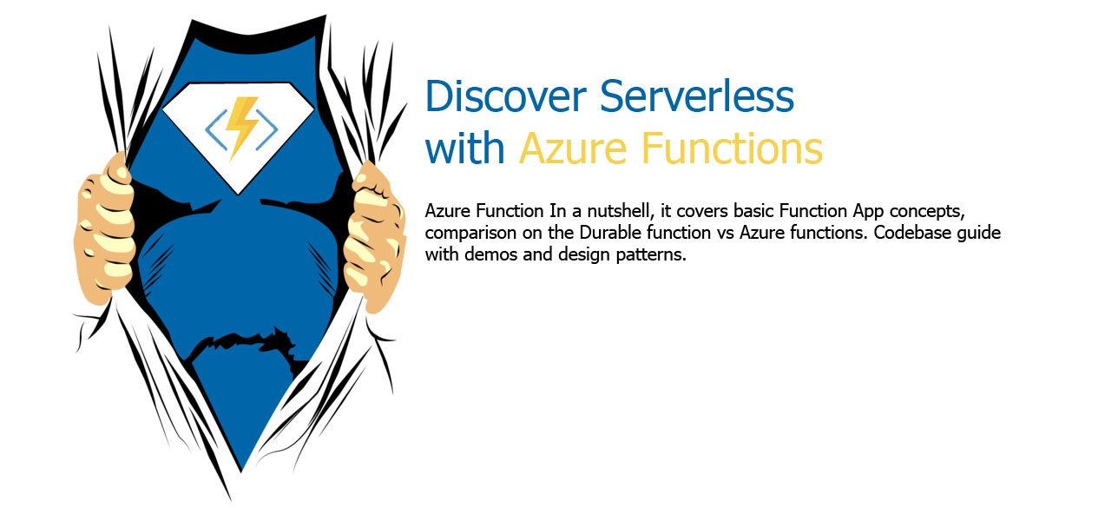


Slide 2
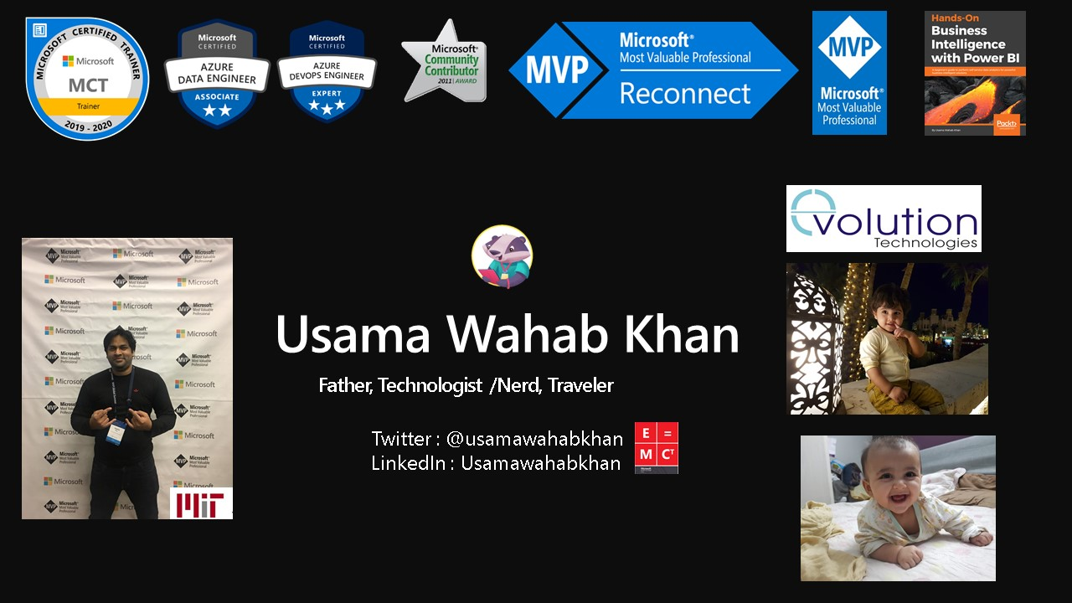

Slide 3
















Introduction
Evolution Technologies is an innovative software-solutions company based in the United Arab Emirates. We are intensely proud of our team of highly professional software engineers and developers. We started our operations in UAE since June 2014 under the Microsoft BizSpark partnership program . Our Products Managing more 6 Billion USD AUM for our clients. One of the most talented Team of Software and business expert in region.
Usama Wahab Khan,
Chief Technology Officer at Evolution Technologies (Microsoft MVP)
Mr. Khan holds the prestigious award of Microsoft Most Valuable Professional (MVP). Indeed, he is one of the most prominent Microsoft architect experts in the Gulf region and MIT Trained Artificial Intelligence Professional. He is a keynote speaker in many conferences, related to various topics such as Microsoft Cloud Technologies , Business Intelligence and AI. He authored Multiple books on Artificial Intelligence Professional ,Machine Learning ,Business Intelligence and digital transformation.
We are Leading Microsoft Cloud Partner and Solution Provider with focus on capital market. Providing state of the art technologies an cloud solution for Private Equity firm , Investment banks and real state fund.
Valuable Clients

Slide 4
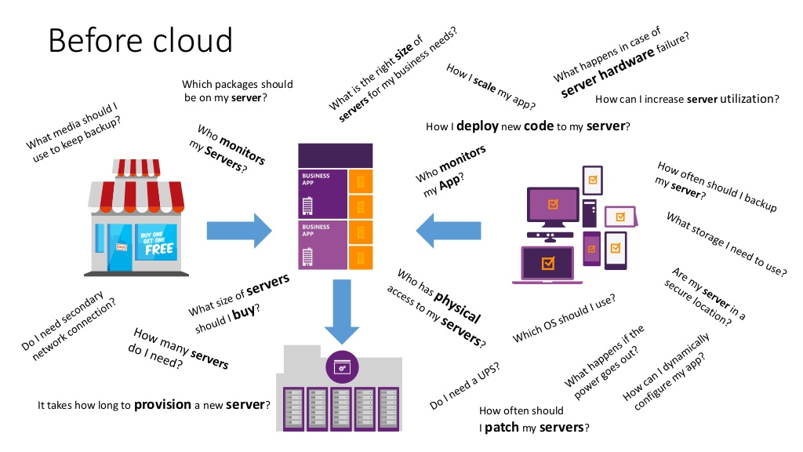

Slide 5
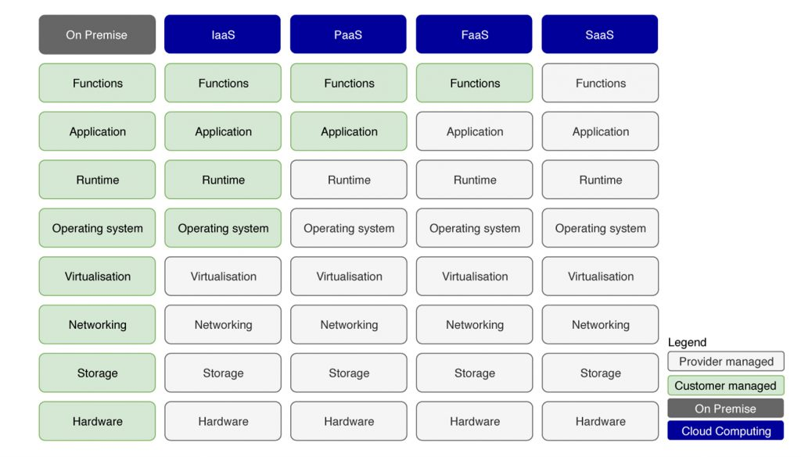
Compareion Cloud Services

Slide 6
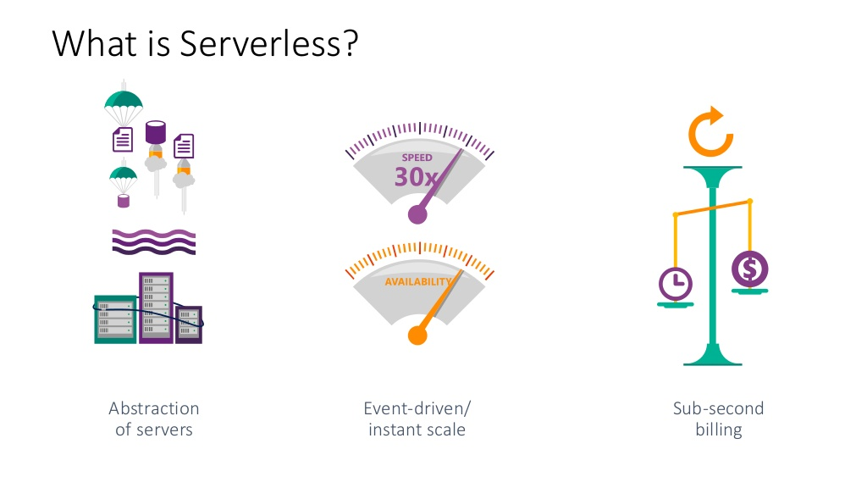

Slide 8
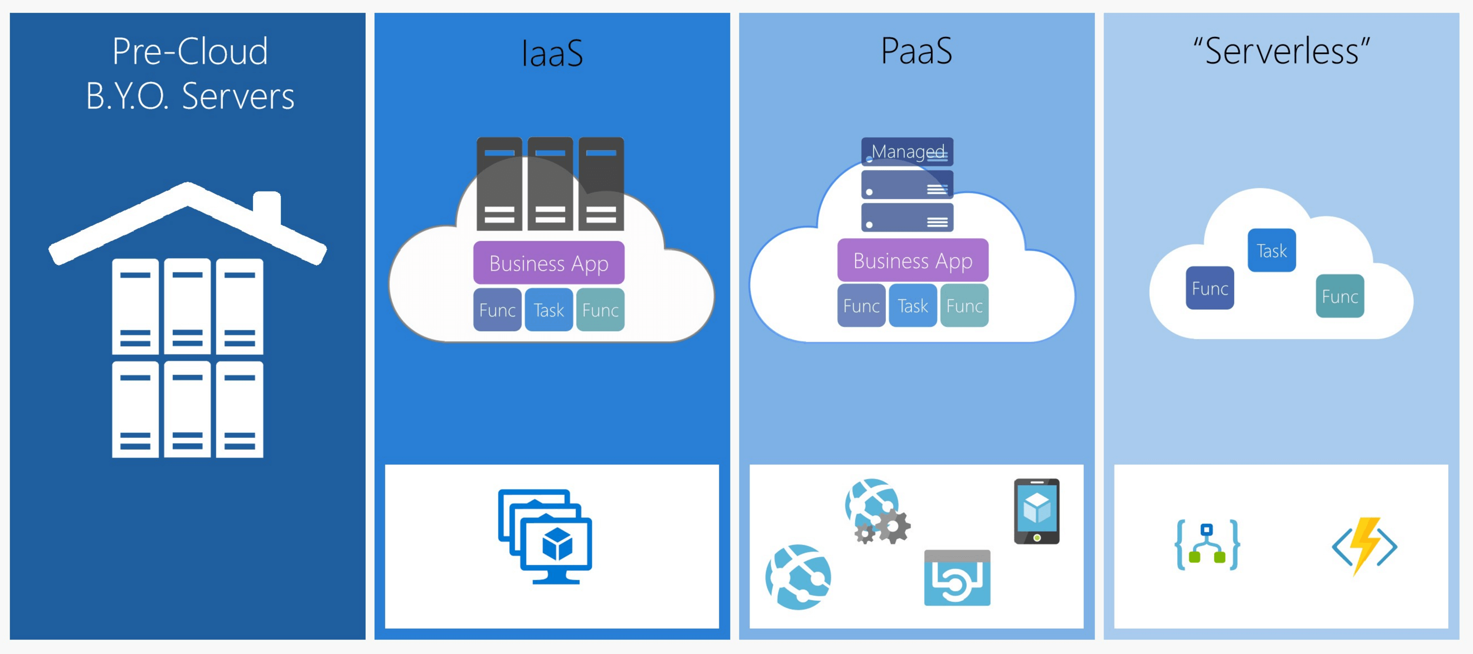
What is Function-as-a-Service (FaaS)?
FaaS is the concept of serverless computing via serverless architectures. Software developers can leverage this to deploy an individual “function”, action, or piece of business logic. They are expected to start within milliseconds and process individual requests and then the process ends.

Slide 9

Serverless Computing (FaaS)
Function as a Service (Azure Functions)
Platform to develop, run, and manage application
Without the complexity of building and maintaining the infrastructure
Similar Technologies
AWS Lambda
Google Cloud Functions
Open Whisk (IBM)

Slide 10



Azure Functions
Code
Azure Functions
Events + data
Process events with Serverless code.
BAM!!!
Make composing Cloud Apps insanely easy
Develop Functions in C#, Node.js, F#, Python, PHP, Batch and more
Easily schedule event-driven tasks across services
Expose Functions as HTTP API endpoints
Scale Functions based on customer demand
Easily integrate with Logic Apps

Slide 11
What can Azure Functions do?
Run code based on HTTP requests
Schedule code to run at predefined times
Process new and modified:
Azure Cosmos DB documents
Azure Storage blobs
Azure Queue storage messages
Respond to Azure Event Grid events by using subscriptions and filters
Respond to high volumes of Azure Event Hubs events
Respond to Azure Service Bus queue and topic messages
Notes:
Microsoft Azure Functions is a powerful solution for processing bulk data, integrating systems, working with the Internet of Things (IoT), and building simple APIs and microservices.
Azure includes a series of templates you can use for the key scenarios that are listed on this slide.

Slide 12
Azure Functions architecture Built on top of App Service and WebJobs SDK
Code
Config
Language Runtime C#, Node.js, F#, PHP, etc.
WebJobs Script Runtime Azure Functions Host – Dynamic Compilation, Language abstractions, etc.
WebJobs Core
Programming model, common abstractions
WebJobs Extensions
Triggers, input and output bindings
App Service Dynamic Runtime Hosting, CI, Deployment Slots, Remote Debugging, etc.

Slide 13












Function integrations
Notification Hubs
Event Grid
Event Hubs
Cosmos DB
Twilio
Azure
Functions
Storage
Service Bus
Queue
Blob
Table
Topics
Queues
Notes:
Azure Functions integrates with various Azure and third-party services. These services can trigger your function and start execution, or they can serve as input and output for your code.
The following service integrations are supported by Azure Functions:
Azure Cosmos DB
Azure Event Hubs
Azure Event Grid
Azure Notification Hubs
Azure Service Bus (queues and topics)
Azure Storage (blob, queues, and tables)
On-premises (using Service Bus)
Twilio (SMS messages)

Slide 14





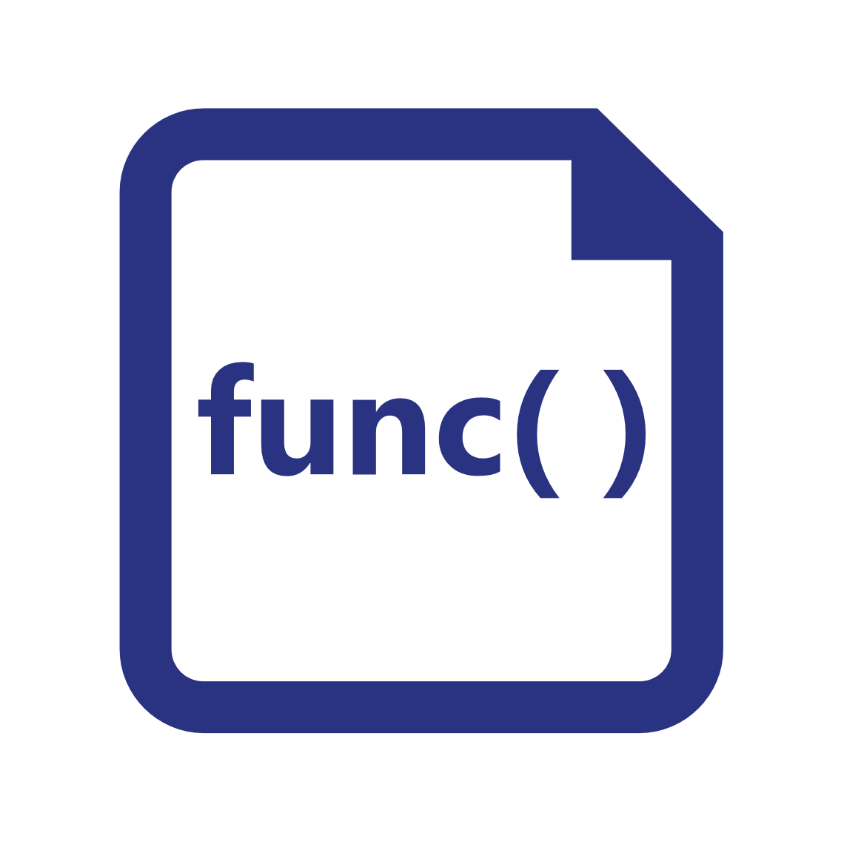




Azure Functions hosting
https://github.com/azure/azure-functions-host (+other repos)
Azure Functions host runtime
Azure Functions Core Tools
Azure Functions base Docker image
Azure Functions .NET Docker image
Azure Functions Node Docker image
●●●
Development
Hosting
Local dev machine
Azure Functions service
Azure Functions service
Azure Functions service
Core Tools + favorite editor
Consumption plan
App Service plan
Premium plan
Platform
+
●●●
Code or container
Code
Code or container
Code or container
App delivery
Windows, macOS, or Linux
Windows or Linux
Windows or Linux
Windows or Linux
OS
Notes:
Azure Functions are designed to be portable and to be hosted in a variety of places, including:
Azure Functions service by using Resource consumption, Premium, or App Service Plans
Internet of Things (IoT) devices
Only Linux containers are supported as of now

Slide 15
Platform and scaling
App Service offers dedicated and dynamic tiers.
Dedicated is the existing App Service plan tiers
Basic, Standard, Premium
Pay based on # of reserved VMs
You’re responsible for scale
Dynamic
Pay on number of executions
Platform responsible for scale

Slide 16
Dynamic Tier Pricing
Pay per execution model - two meters, three units
Number of executions
Duration of execution x reserved memory

Slide 17


Input and Output Bindings
Service
Input bindings
Output bindings
Output bindings
Trigger
Function
Input bindings
Service
Service
Notes:
Input and output bindings provide a declarative way to connect to data from within your code. Bindings are optional and an Azure Function can have multiple input and output bindings.

Slide 18
Trigger types
Triggers based on Azure services:
Cosmos DB
Blob and queues
Service Bus
Event Hub
Triggers based on common scenarios:
HTTP request
Scheduled timer
Triggers based on third-party services:
GitHub
And more…
Notes:
There are many types of triggers for Azure services including:
HTTPTrigger - Trigger the execution of your code by using an HTTP request.
TimerTrigger - Execute cleanup or other batch tasks on a predefined schedule.
GitHub webhook - Respond to events that occur in your GitHub repositories. Generic webhook - process webhook HTTP requests from any service that supports webhooks.
CosmosDBTrigger - Process Azure Cosmos DB documents when they are added or updated in collections in a NoSQL database.
BlobTrigger - Process Azure Storage blobs when they are added to containers. You might use this function for image resizing.
QueueTrigger - Respond to messages as they arrive in an Azure Storage queue.
EventHubTrigger - Respond to events delivered to an Azure Event Hub. Particularly useful in application instrumentation, user experience, or workflow processing, and Internet of Things (IoT) scenarios.
ServiceBusQueueTrigger - Connect your code to other Azure services or on-premises services by listening to message queues.
ServiceBusTopicTrigger - Connect your code to other Azure services or on-premises services by subscribing to topics.

Slide 19



Trigger and Bindings example
L
Blobs
Azure Storage
Schedule trigger
Logs
Query docs
Function
P
Cosmos DB input binding
Event Hubs
Notes:
In this example, the Function is triggered by a recurring schedule (nightly) and queries Azure Cosmos DB for a set of documents. The function then processes the documents, outputs blobs to Azure Storage, and outputs logs to Event Hubs.

Slide 20

Demo Azure function

Slide 21
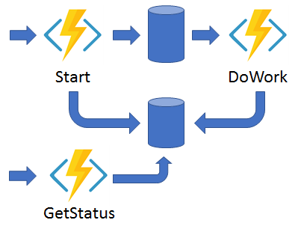
Durable Functions
Durable Functions is an extension of Azure Functions. You can use Durable Functions for stateful orchestration of function execution. A durable function app is a solution that's made up of different Azure functions. Functions can play different roles in a durable function orchestration.
Notes:
Durable Functions is an extension of Azure Functions and Azure WebJobs that lets you write stateful functions in a serverless environment. The extension manages state, checkpoints, and restarts for you.
The extension lets you define stateful workflows in a new type of function called an Orchestrator function. Here are some of the advantages of Orchestrator functions:
They define workflows in code. No JSON schemas or designers are needed.
They can call other functions synchronously and asynchronously. Output from called functions can be saved to local variables.
They automatically checkpoint their progress whenever the function awaits. Local state is never lost if the process recycles or the virtual machine (VM) reboots.
Note: Durable Functions is an advanced extension for Azure Functions that is not appropriate for all applications. The rest of this section assumes that you have a strong familiarity with Azure Functions concepts and the challenges involved in serverless application development.
The primary use case for Durable Functions is simplifying complex, stateful coordination problems in serverless applications.

Slide 22
Durable Functions
Write stateful functions in a stateless environment
Manages state, checkpoints, and restarts
Defines an Orchestrator function
Workflows are defined in code
Calls other functions synchronously or asynchronously
Checkpoint progress whenever function awaits
Notes:
Durable Functions is an extension of Azure Functions and Azure WebJobs that lets you write stateful functions in a serverless environment. The extension manages state, checkpoints, and restarts for you.
The extension lets you define stateful workflows in a new type of function called an Orchestrator function. Here are some of the advantages of Orchestrator functions:
They define workflows in code. No JSON schemas or designers are needed.
They can call other functions synchronously and asynchronously. Output from called functions can be saved to local variables.
They automatically checkpoint their progress whenever the function awaits. Local state is never lost if the process recycles or the virtual machine (VM) reboots.
Note: Durable Functions is an advanced extension for Azure Functions that is not appropriate for all applications. The rest of this section assumes that you have a strong familiarity with Azure Functions concepts and the challenges involved in serverless application development.
The primary use case for Durable Functions is simplifying complex, stateful coordination problems in serverless applications.

Slide 23
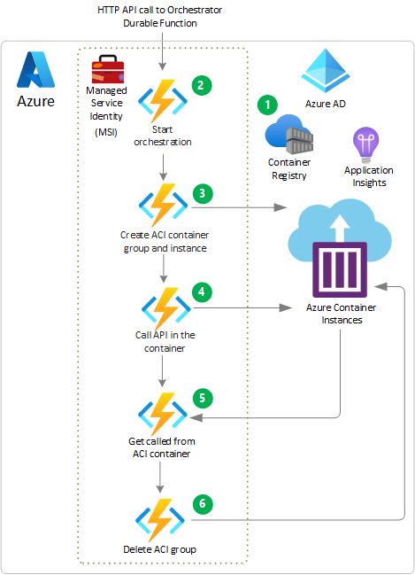
Example :Serverless batch processing with Durable Functions in Azure Container Instances
The batch processing job is packaged into a container image stored in Azure Container Registry (ACR), ready to deploy with options like AKS, Service Fabric, or ACI.
An HTTP trigger invokes the orchestrator function to orchestrate the container deployment.
An activity function uses the container image stored in ACR to create an ACI container in a container group.
The orchestrator function uses the container URL to call and start the batch processing job on the container instance, and to monitor job progress.
Once the job completes, the batch processing job invokes the orchestrator function by raising an external event, and provides job status Completed or Failed.
Depending on job status, the orchestrator function stops, restarts, or deletes the container group.

Slide 24

Durable Function scenario - Chaining
Function chaining refers executing a sequence of functions in a particular order. Often, the output of one function needs to be applied to the input of another function.
F1
F2
F3
F4
Notes:
Function chaining refers to the pattern of executing a sequence of functions in a particular order. Often, the output of one function needs to be applied to the input of another function.

Slide 25
Durable Function scenario - Fan-out/fan-in
Fan-out/fan-in refers to the pattern of executing multiple functions in parallel, and then waiting for all to finish
F1
F3
F2
Notes:
Fan-out/fan-in refers to the pattern of executing multiple functions in parallel, and then waiting for all to finish. Often, some aggregation work is done on results returned from the functions.
With normal functions, fanning out can be done by having the function send multiple messages to a queue. However, fanning back in is much more challenging. You'd have to write code to track when the queue-triggered functions end and store function outputs. The Durable Functions extension handles this pattern with relatively simple code.

Slide 26
Durable Function scenario - Async HTTP APIs
Durable Functions provides built-in APIs that simplify the code that you write for interacting with long-running function executions
Start
DoWork
GetStatus
Notes:
The third pattern is all about the problem of coordinating the state of long-running operations with external clients. A common way to implement this pattern is by having the long-running action triggered by an HTTP call, and then redirecting the client to a status endpoint that they can poll to learn when the operation completes.
Durable Functions provides built-in APIs that simplify the code you write for interacting with long-running function executions. After an instance is started, the extension exposes webhook HTTP APIs that query the Orchestrator function status. The following example shows the REST commands to start an Orchestrator and to query its status. For clarity, some details are omitted from the example.

Slide 27
Durable Function scenario - Monitoring
The monitor pattern refers to a flexible recurring process in a workflow—for example, polling until certain conditions are met
Notes:
The monitor pattern refers to a flexible recurring process in a workflow—for example, polling until certain conditions are met. A regular timer-trigger can address a simple scenario, such as a periodic cleanup job, but its interval is static and managing instance lifetimes becomes complex. Durable Functions enables flexible recurrence intervals, task lifetime management, and the ability to create multiple monitor processes from a single orchestration.
An example would be reversing the earlier async HTTP API scenario. Instead of exposing an endpoint for an external client to monitor a long-running operation, the long-running monitor consumes an external endpoint, waiting for some state change.
Using Durable Functions, multiple monitors that observe arbitrary endpoints can be created in a few lines of code. The monitors can end execution when some condition is met, or be terminated by the DurableOrchestrationClient, and their wait interval can be changed based on some condition (that is, exponential backoff). The code on the next slide implements a basic monitor.

Slide 28



Durable Function scenario - Human interaction
Many processes involve human interaction. Automated processes must allow for human low availability, and they often do so by using time-outs and compensation logic.
ProcessApproval
RequestApproval
Escalate
Notes:
Many processes involve some kind of human interaction. The tricky thing about involving humans in an automated process is that people are not always as highly available and responsive as cloud services. Automated processes must allow for this, and they often do so by using timeouts and compensation logic.
One example of a business process that involves human interaction is an approval process. For example, approval from a manager might be required for an expense report that exceeds a certain amount. If the manager does not approve within 72 hours (maybe the manager went on vacation), an escalation process starts to get the approval from someone else (perhaps the manager's manager).
This pattern can be implemented by using an Orchestrator function. The Orchestrator would use a durable timer to request approval and escalate in case of timeout. It would wait for an external event, which would be the notification generated by some human interaction.

Slide 29
Durable Function scenario - Chaining code
[FunctionName("Chaining")]
public static async Task<object> Run(
[OrchestrationTrigger] IDurableOrchestrationContext context)
{
try
{
var x = await context.CallActivityAsync<object>("F1", null);
var y = await context.CallActivityAsync<object>("F2", x);
var z = await context.CallActivityAsync<object>("F3", y);
return await context.CallActivityAsync<object>("F4", z);
}
catch (Exception)
{
// Error handling or compensation goes here.
}
}
Notes:
The values "F1", "F2", "F3", and "F4" are the names of other functions in the function app. Control flow is implemented by using normal imperative coding constructs. That is, code executes top down and can involve existing language control flow semantics, like conditionals and loops. Error handling logic can be included in try/catch/finally blocks.
The ctx parameter (DurableOrchestrationContext) provides methods for invoking other functions by name, passing parameters, and returning function output. Each time the code calls await, the Durable Functions framework checkpoints the progress of the current function instance. If the process or VM recycles midway through the execution, the function instance resumes from the previous await call. We will cover more on this restart behavior later.

Slide 30
Durable Function scenario - Fan-out/fan-in code
[FunctionName("FanOutFanIn")]
public static async Task Run([OrchestrationTrigger] IDurableOrchestrationContext context)
{
var parallelTasks = new List<Task<int>>();
// Get a list of N work items to process in parallel.
object[] workBatch = await context.CallActivityAsync<object[]>("F1", null);
for (int i = 0; i < workBatch.Length; i++)
{
Task<int> task = context.CallActivityAsync<int>("F2", workBatch[i]);
parallelTasks.Add(task);
}
await Task.WhenAll(parallelTasks);
// Aggregate all N outputs and send the result to F3.
int sum = parallelTasks.Sum(t => t.Result);
await context.CallActivityAsync("F3", sum);
}
Notes:
The fan-out work is distributed to multiple instances of function F2, and the work is tracked by using a dynamic list of tasks. The .NET Task.WhenAll API is called to wait for all the called functions to finish. Then the F2 function outputs are aggregated from the dynamic task list and passed on to the F3 function.
The automatic checkpointing that happens at the await call on Task.WhenAll ensures that any crash or reboot midway through does not require a restart of any already completed tasks.

Slide 31
Thank you

